Slide 1
Project Based Learning -II
Team Details:
Ashank Yadav (2110993768)
Harshit Behl (2110993788)
Chirag Goyal (2110993871)
Faculty Coordinator: Dr. Kamal Deep Garg Sir
:
Chitkara University Institute of Engineering and Technology,
Chitkara University, Punjab

Slide 2
Table of Contents
Introduction
Research Objectives
Dataset
Pre-Processing of dataset
Model Details
Flowchart
Experiments
Results
Analysis
Conclusion

Slide 3
Introduction
FAKE NEWS PREDICTOR
Fake news predictor is a web application which checks the validity of the news.
Created by team members:
Ashank Yadav (2110993768)
Harshit Behl (2110993788)
Chirag Goyal (2110993871)
The project aims to filter and validate the information that reaches us today.

Slide 4
Research Objectives
Fake news, news articles that are intentionally and verifiably false and are designed to manipulate people’s perceptions of reality. It’s been often used to influence politics and promote advertising.
Our project aims to detect such information and filter it.

Slide 5
Dataset
The dataset for fake news detection consists of 20,000 rows and following features, taken from Kaggle.
Title: This column contains the titles or headlines of the news articles.
Author: This column contains the names or identities of the authors who wrote the news articles.
Text: This column contains the main body of the news articles. It includes the detailed information, facts, and statements presented in the news.
Label: This column is used for labelling the news articles as real or fake. It assigns a binary value (0 or 1) to indicate whether the news is considered genuine or fraudulent. A label of 0 typically represents real news, while a label of 1 represents fake news.

Slide 6
Pre-Processing of dataset
First, the presence of null values was checked in the data. Only a few of the rows had null values which were then replaced with empty string.
We have feature engineered and combined the 'Author' and 'Title' columns together to create a single text field that contains both the author's name and the news title. By concatenating these columns, we are creating a consolidated textual representation that captures both the source of the news and a concise summary of its content.
We have applied the Porter Stemmer algorithm to the pre-processed text.
After stemming the text, we have utilized the TF-IDF technique on the pre-processed data.

Slide 7
Model Details
The machine learning model Random Forest was used.
It is a supervised learning model used for predicting categorical output.
The model here takes pre-processed data generates a binomial output.

Slide 8
Flowchart
Data Loading
Stemming and Vectorize
ML Model
Classification

Slide 9
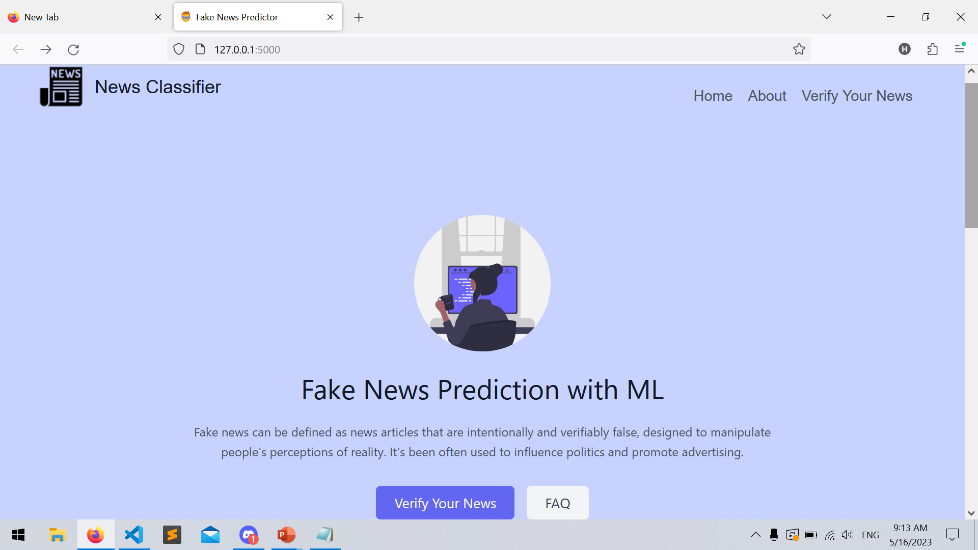
Results

Slide 10
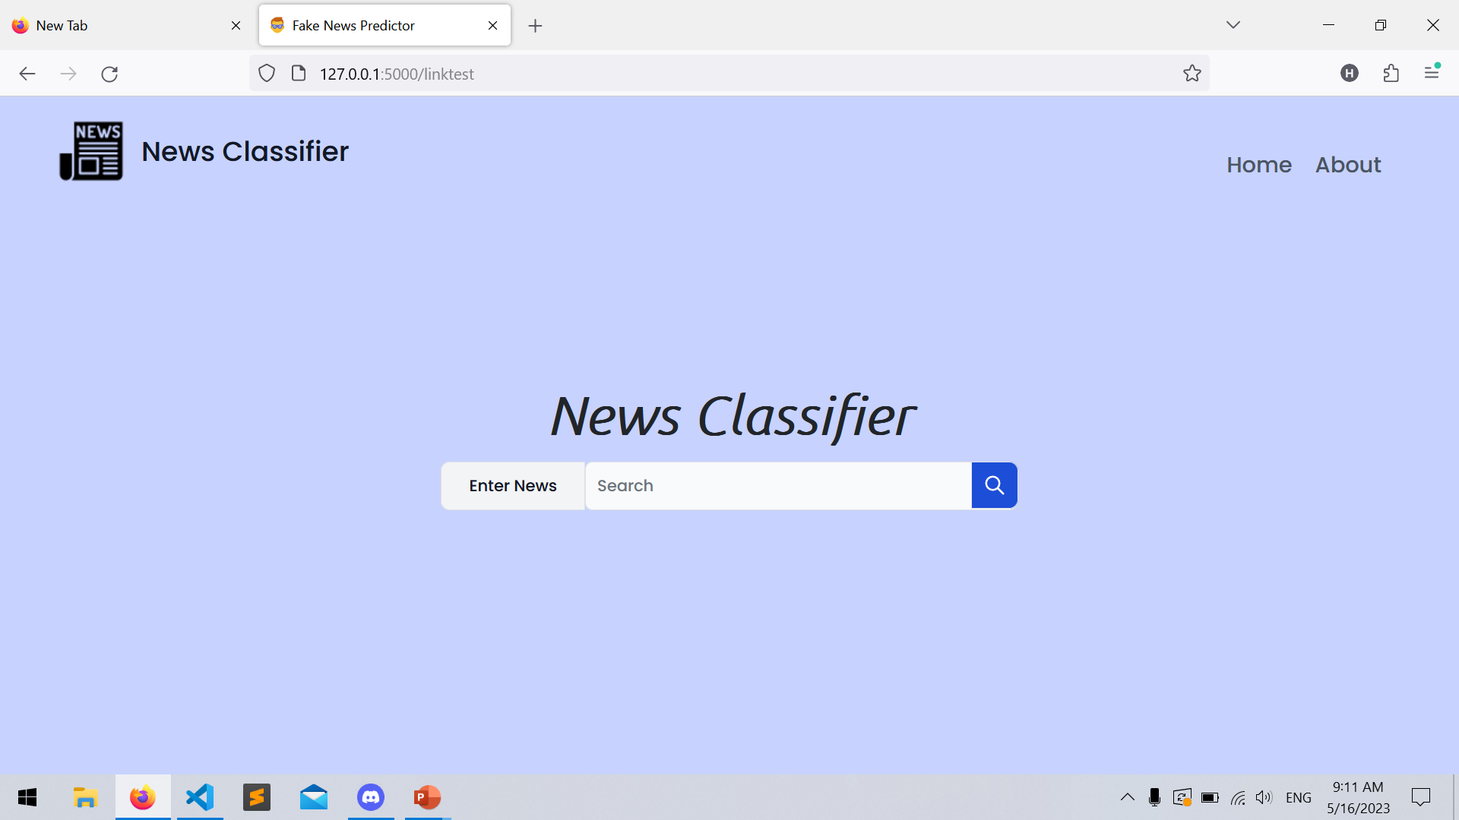

Slide 11
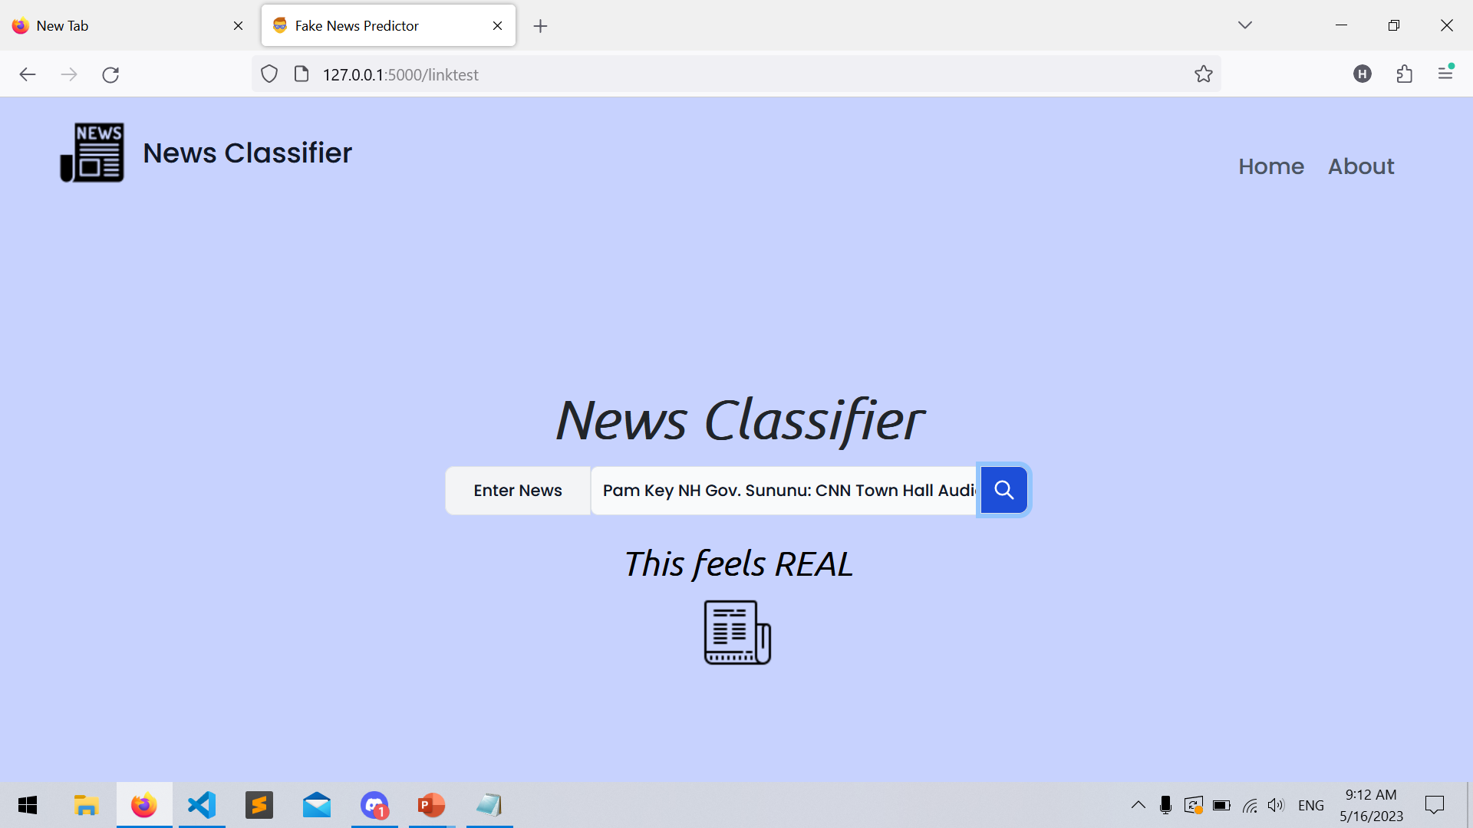

Slide 12
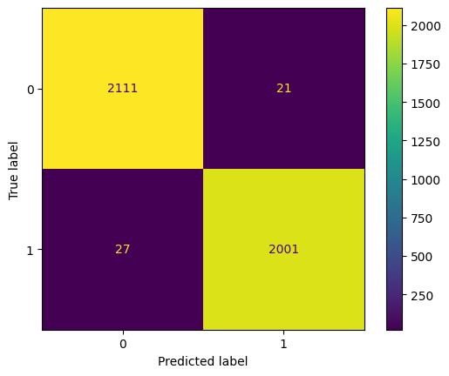
Analysis

Slide 13
Conclusion
The Classification Model reached the F1 Score of 0.99.
The harmonic mean used in the F1 score balanced the precision and recall.

Slide 14


